Slide 1
☕ BRIGHT COFFEE SHOP Sales & Performance Dashboard Presentation Purpose: To explore transaction trends, identify revenue drivers, and evaluate store-level performance. Dataset: coffee.analysis.coffee_analysis Analyst: Mahura Kegomoditswe | Date: 27 Oct 2025

Slide 2
The Story: Consistent Growth with Clear Opportunities Our business is on a strong growth trajectory, but our data reveals specific patterns we can leverage to accelerate further.

Slide 3
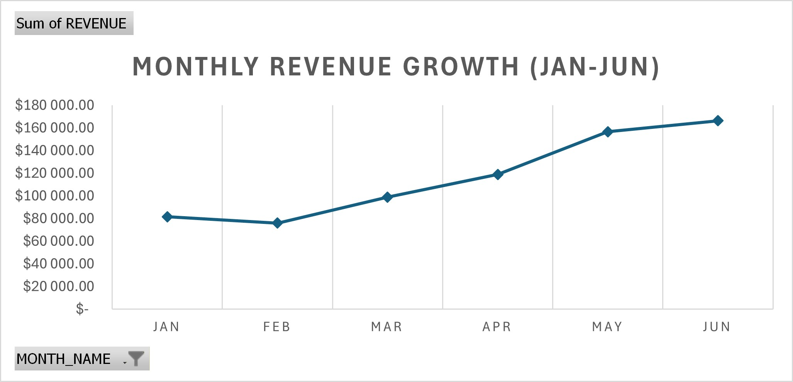
The Growth Engine: Steady & Reliable What it shows: A consistent month-over-month revenue increase, culminating in a strong June. The Story: "We have built strong, predictable momentum. Our foundation is solid, and we are on a clear upward track."

Slide 4
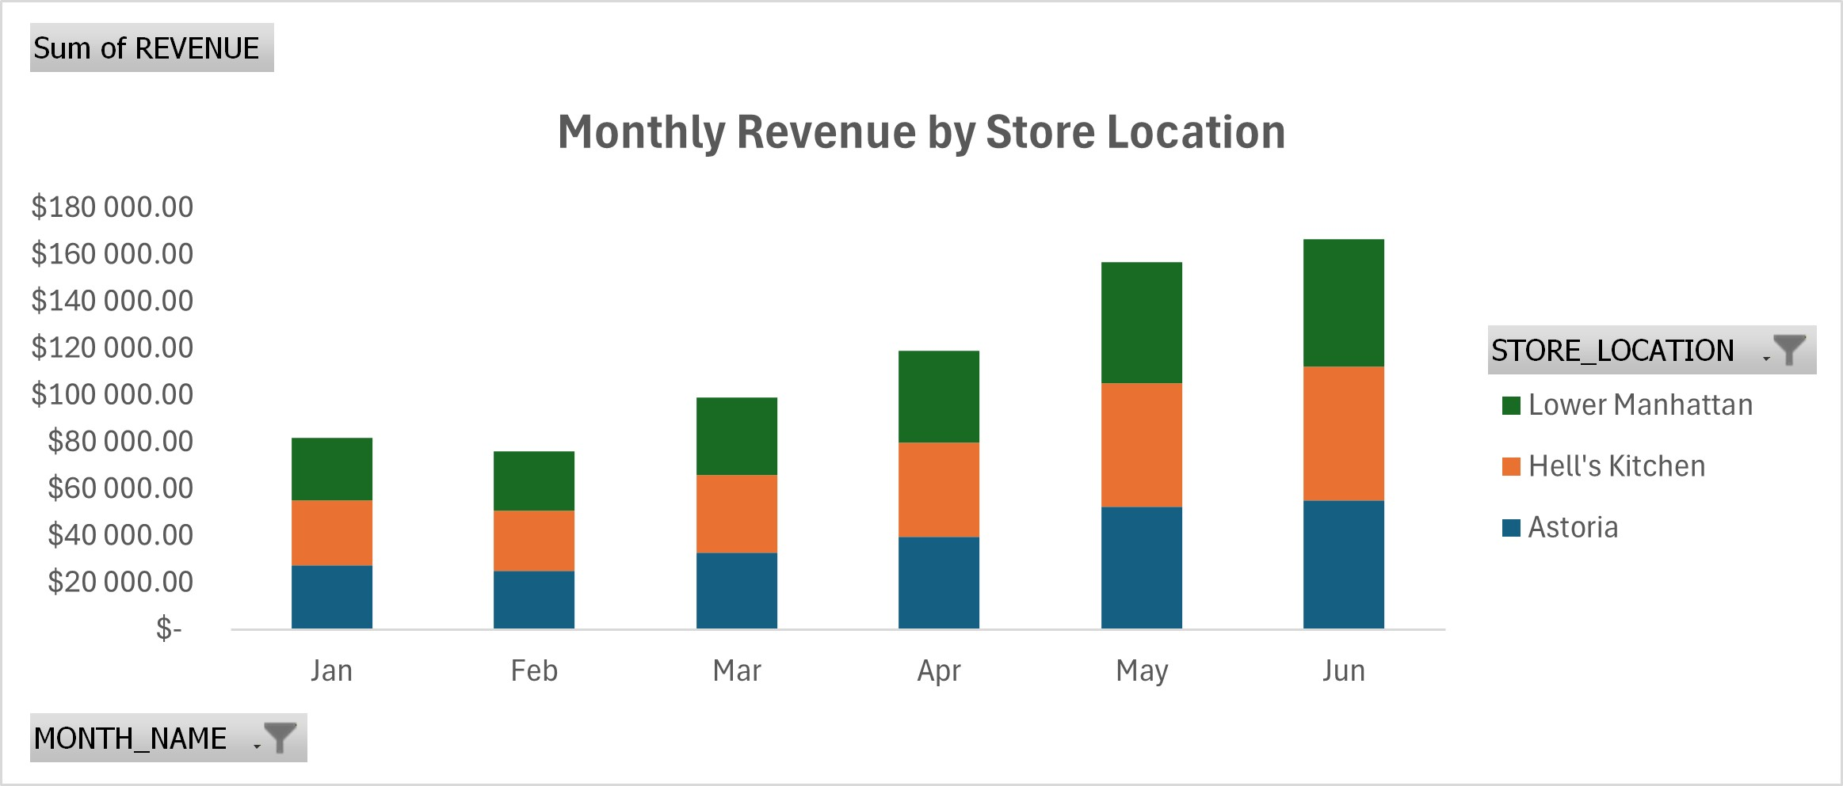
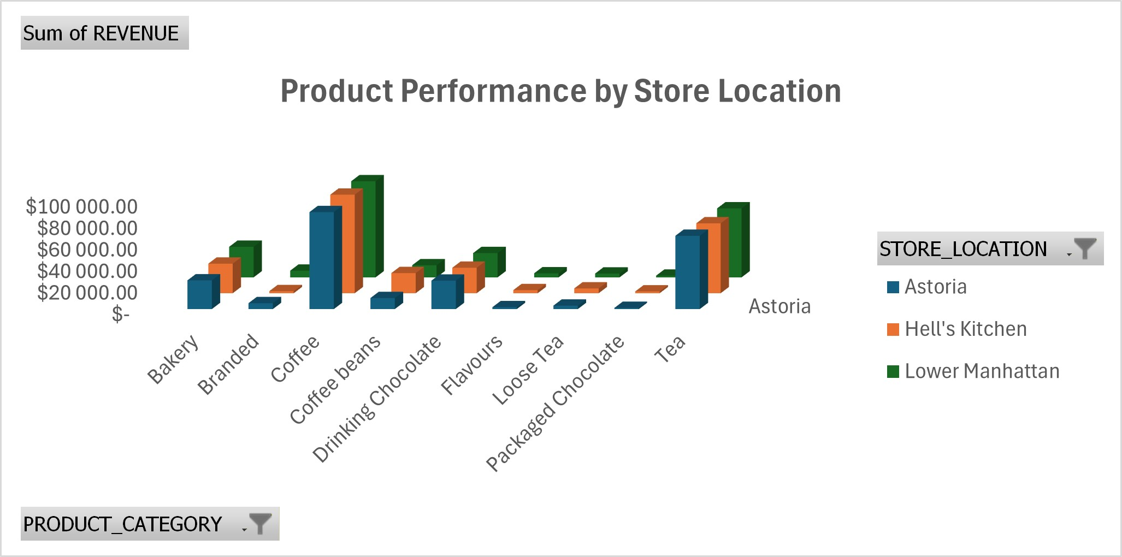
The Power Player: Lower Manhattan & Bakery Coffee What it shows: Lower Manhattan is our most consistently high-performing store. Bakery Branded Coffee is our undisputed star product across all locations. The Story: "We have a winning formula. The combination of our premium coffee in our flagship location is our core engine. However, this also highlights a significant opportunity to lift performance in Astoria."

Slide 5
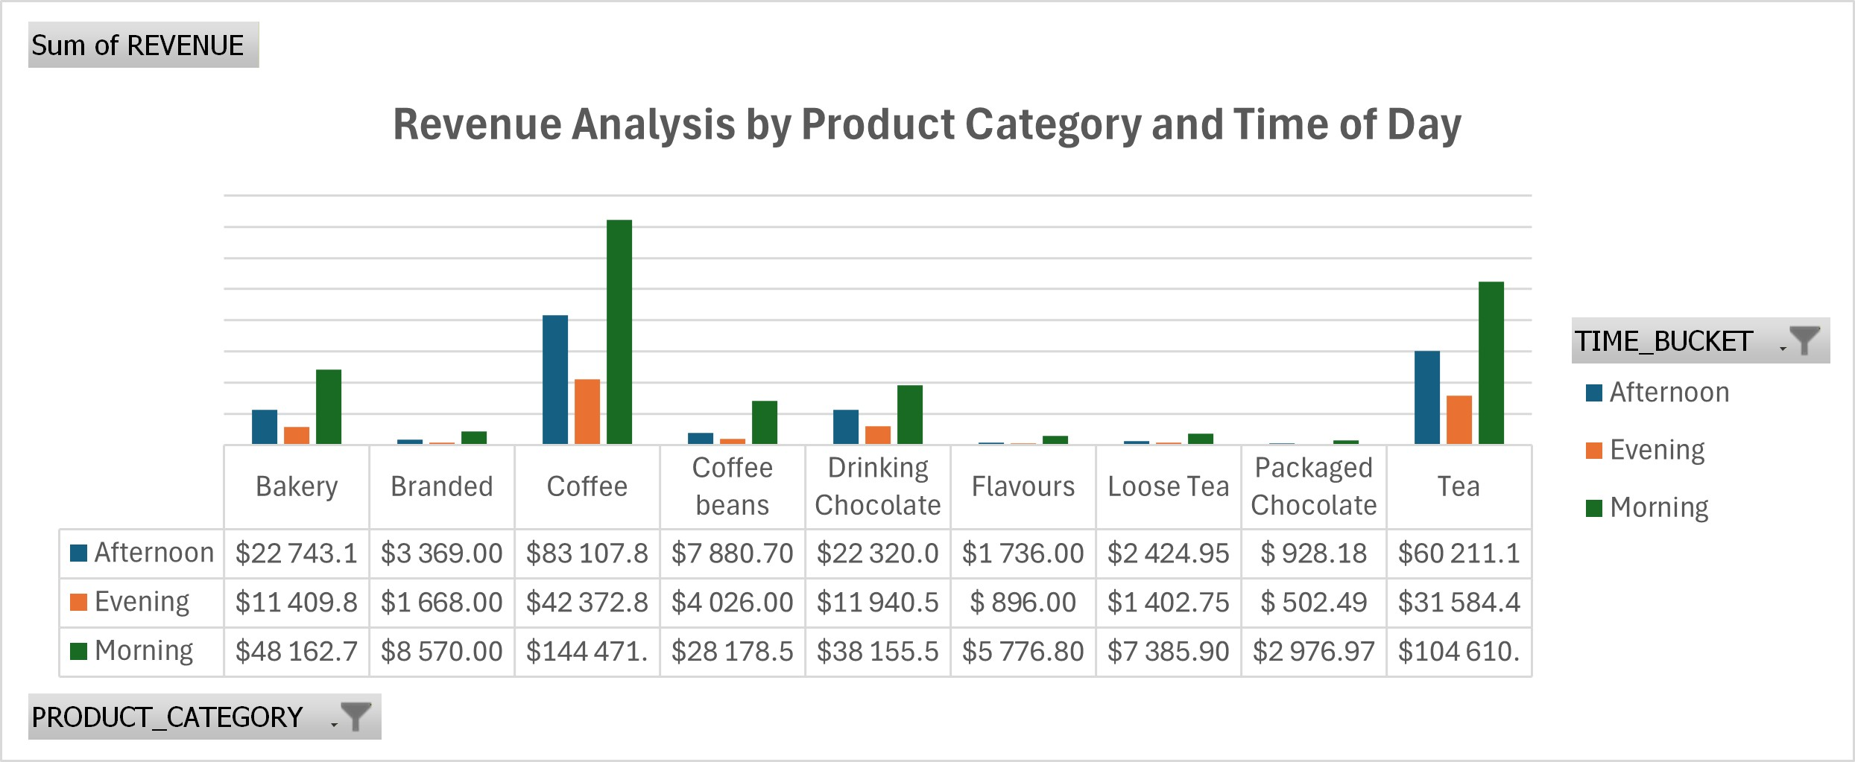
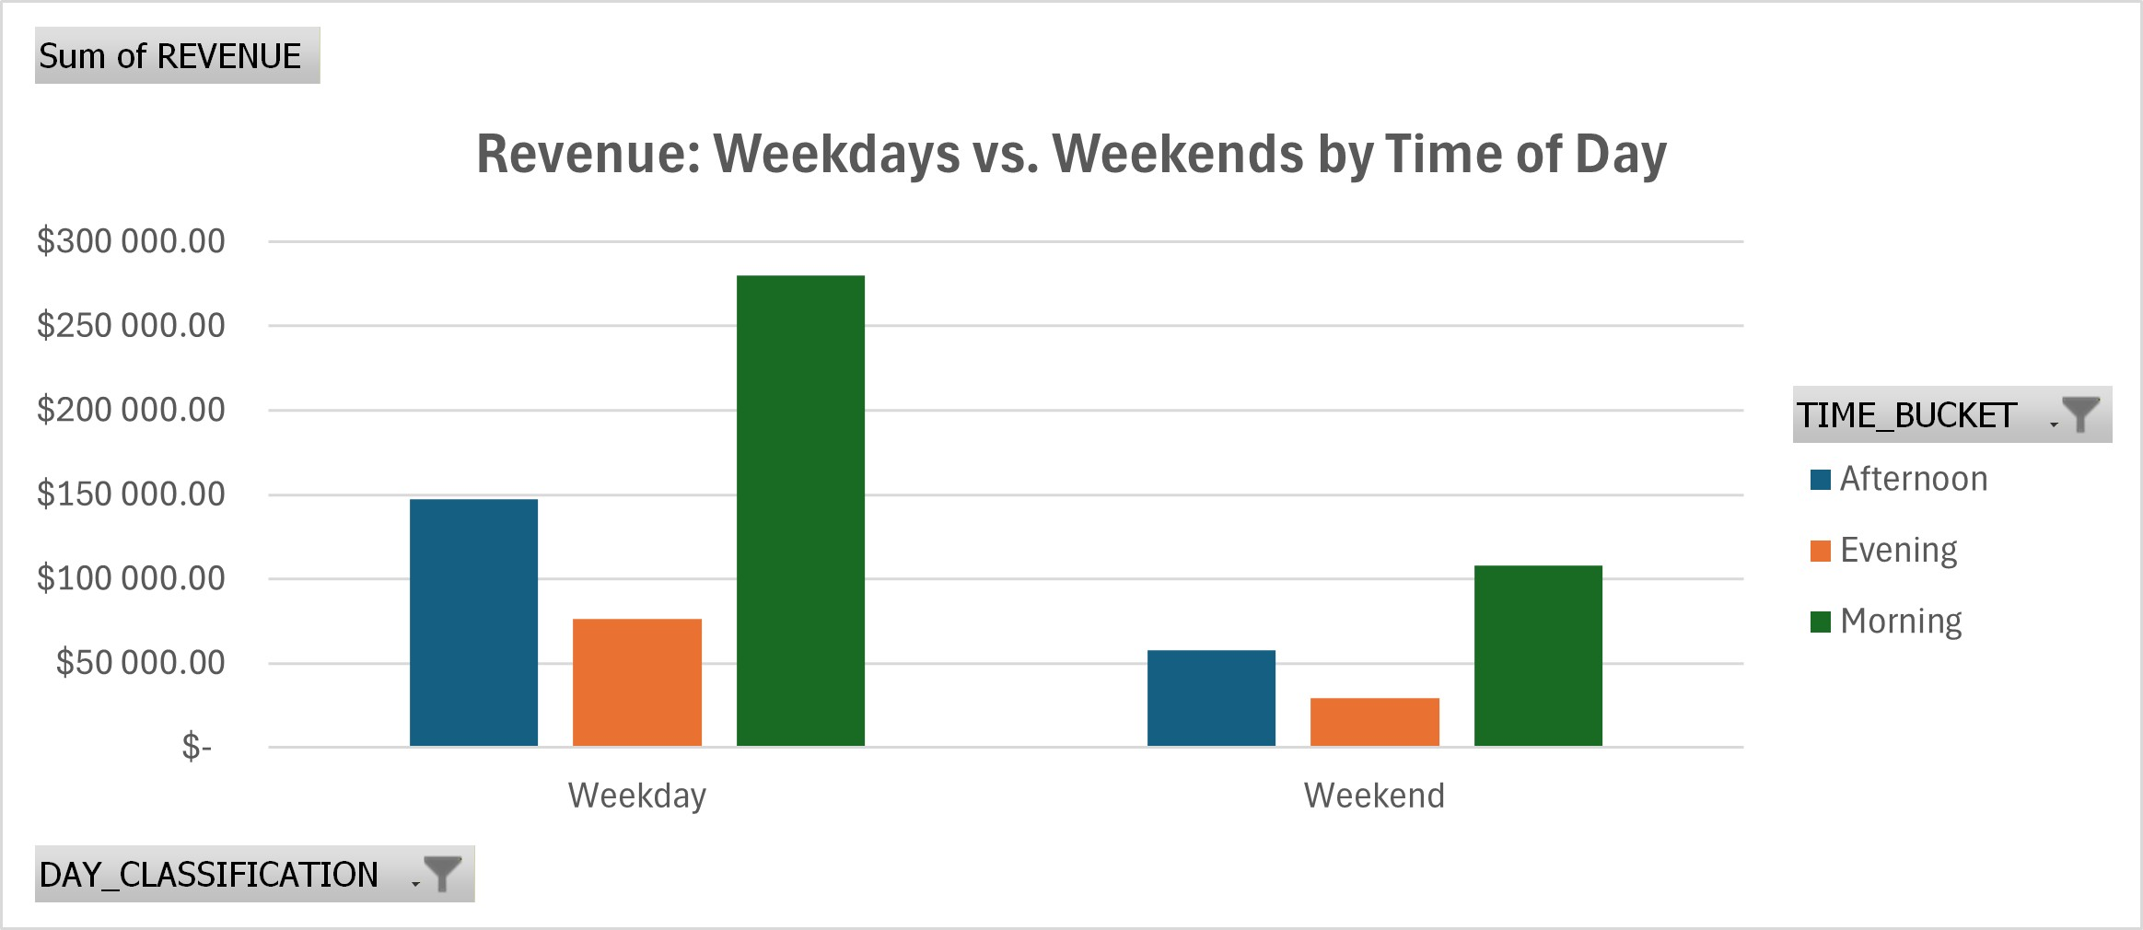
The Customer Rhythm: Mornings & Weekends Drive Profit What it shows: Mornings are by far our most profitable time-period, driven by coffee. Weekends generate a massive amount of revenue, with a much higher proportion coming from indulgent products like Drinking Chocolate and Flavours. The Story: "Our customers' routines define our business. We are their morning ritual and their weekend treat. Our evening and weekday performance, however, is our untapped potential."

Slide 6
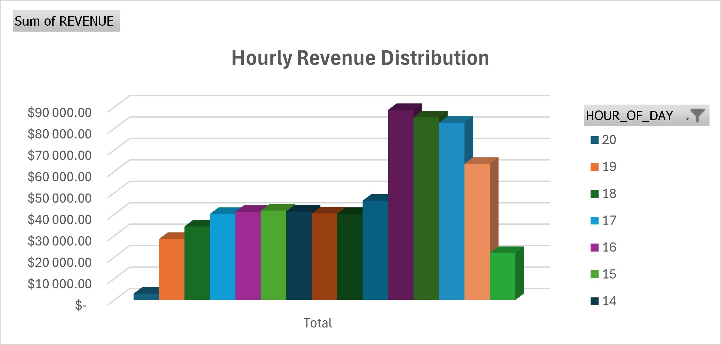
The Golden Hour: 10 AM Peak
What it shows: Revenue peaks dramatically around 10 AM.
The Story: "The mid-morning rush is our daily golden hour. This is when we capture the majority of our daily value."

Slide 7
Strategic Recommendations for the CEO
1. Double Down on What Works:
Scale the "Lower Manhattan Playbook": Analyze and replicate its operations, staffing, and customer experience in Hell's Kitchen and Astoria.
Launch a "Signature Coffee" Program: Create a subscription or loyalty program around Bakery Branded Coffee to secure our morning customer base.
2. Attack the Untapped Potential:
The "Weekend Indulgence" Menu: Bundle high-margin weekend favorites (Drinking Chocolate, Flavours, Packaged Chocolate) into premium gift sets or promotions.
The "Evening Revitalization" Project: Test an evening "Happy Hour" on weekdays for pastries and chocolate-based drinks to boost weak post-work traffic.
3. Operational Excellence:
Peak-Performance Staffing: Align schedules precisely to handle the 8 AM - 11 AM rush and weekend peaks, ensuring service quality doesn't slip.
Astoria Turnaround Task Force: Immediately investigate the root cause of Astoria's underperformance (e.g., local marketing, competition, foot traffic) and implement a location-specific rescue plan.

